Slide 1
CSS342 Data Structures, Algorithms, and Discrete Mathematics (I)

Slide 2
Goals by the end of this week (10/22, 10/24)
ADT: Stack, Queue (Tuesday)
Algorithms: recursion (Thursday)
Homework
Have your testing environment setup
No copy & paste from browser to IDE/Editor
Comfortable with CMake & Googletest
Midterm review
2nd session of Thursday class
Study group

Slide 3
Linked List in-class lab 1
Given the head pointer (assuming with dummy head node)
Find the pointer to the N-th node from the end of the list
Head → 0 → 1 → 2 → 3 → 4 → 5 → end
N=7
N=4
N=2
N=1

Slide 4
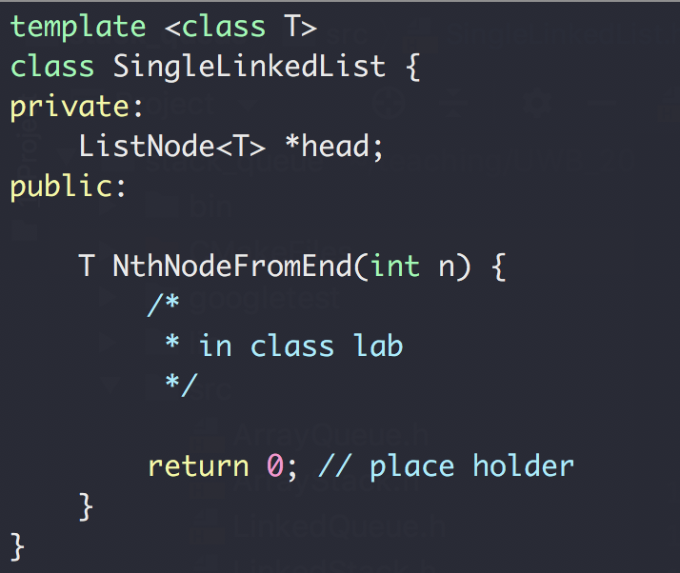
Linked List in-class lab 1
Given the head pointer (assuming with dummy head node)
Find the pointer to the N-th node from the end of the list

Slide 5
Linked List in-class lab 1
Given the head pointer (assuming with dummy head node)
Find the pointer to the N-th node from the end of the list
Head → 0 → 1 → 2 → 3 → 4 → 5 → end
p0
p1
p1
p1
N=4

Slide 6
Linked List in-class lab 1
Given the head pointer (assuming with dummy head node)
Find the pointer to the N-th node from the end of the list
2
Head → 0 → 1 → 2 → 3 → 4 → 5 → end
p0
p0
p1
p1
N=4
N=4

Slide 7

Linked List in-class lab 2
Given the head pointer (assuming with dummy head node)
Find whether the list has a loop
Head → 0 → 1 → 2 → 3 → 4 → 5
8
7
6

Slide 8
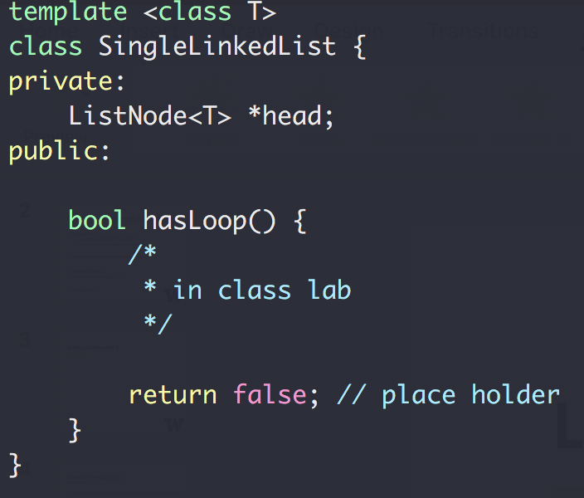
Linked List in-class lab 2
Given the head pointer (assuming with dummy head node)
Find whether the list has a loop

Slide 9
Linked List in-class lab 2
Given the head pointer (assuming with dummy head node)
Find whether the list has a loop
Head → 0 → 1 → 2 → 3 → 4 → 5
8
7
6

Slide 10
Linked List in-class lab 2
Given the head pointer (assuming with dummy head node)
Find whether the list has a loop
p0
p0
p0
p0
p1
Head → 0 → 1 → 2 → 3 → 4 → 5
p1
p1
8
7
6
p1

Slide 11
ADT: Stack
Design a Stack ADT
First in, last out
Usage: reverse a list, and many others

Slide 12
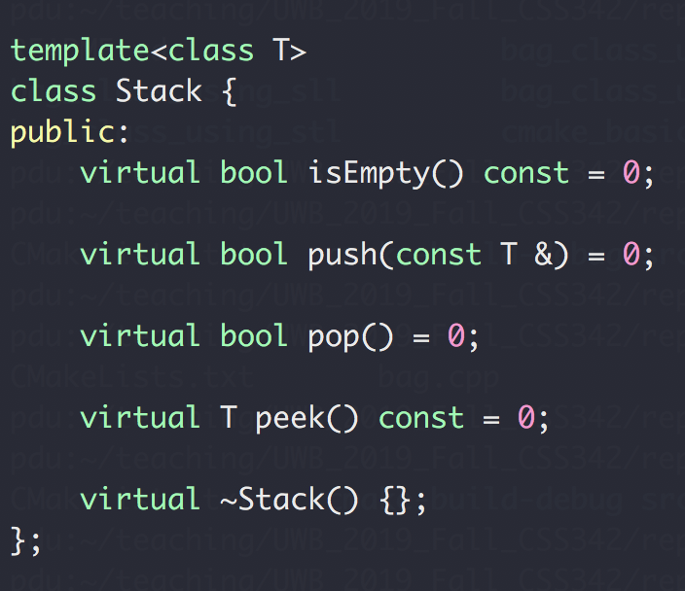
ADT Stack
Design a Stack ADT
First in, last out
Interface →

Slide 13
ADT Stack Exercise
Given a string containing just the characters '(', ')', '{', '}', '[' and ']', determine if the input string is valid.
An input string is valid if:
Open brackets must be closed by the same type of brackets
Open brackets must be closed in the correct order
An empty string is also considered valid.
https://leetcode.com/problems/valid-parentheses/

Slide 14
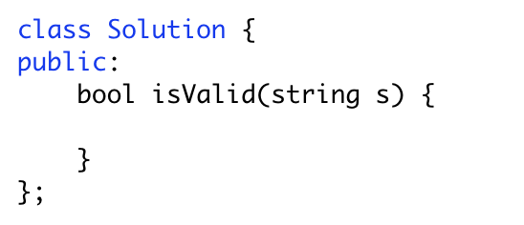
ADT Stack Exercise
Input: ( )
Output: true
Input: ( ]
Output: false
Output: true
Output: true
Input: ( ) [ ] { }
Output: true
Input: ( [ ) ]
Output: false
Input: { [ ] }
Output: true
Output: true
Output: true
Output: true

Slide 15
ADT Stack Exercise
Input: ( [ ] ) { }
push(‘(‘)
Stack: (

Slide 16
ADT Stack Exercise
Input: ( [ ] ) { }
push(‘[‘)
Stack: ( [

Slide 17
ADT Stack Exercise
Input: ( [ ] ) { }
pop (‘[‘)
Stack: (

Slide 18
ADT Stack Exercise
Input: ( [ ] ) { }
pop (‘(‘)
Stack:

Slide 19
ADT Stack Exercise
Input: ( [ ] ) { }
push(‘{‘)
Stack: {

Slide 20
ADT Stack Exercise
Input: ( [ ] ) { }
pop(‘}‘)
Stack:
STACK EMPTY ➔ return true

Slide 21
ADT Stack Exercise
https://www.geeksforgeeks.org/check-for-balanced-parentheses-in-an-expression/
Input: ( [ } ) { }
Stack: (
Stack: ( [
STACK not empty ➔ return false
Stack: ( [ }
Stack: ( [ } )
Stack: ( [ } ) {
Stack: ( [ } )

Slide 22
ADT Stack
Now let’s talk about implementation
Possible options?
Array
Primitive array T **
std::vector<T*>
Pros & cons?
List (single linked list)
Pros & cons?

Slide 23
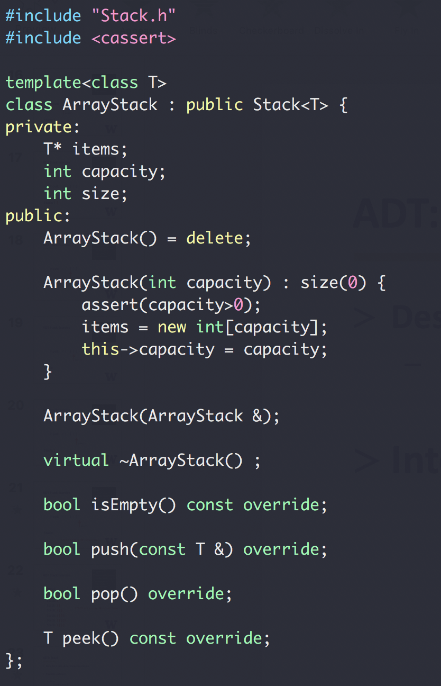
ADT Stack
Array Implement

Slide 24
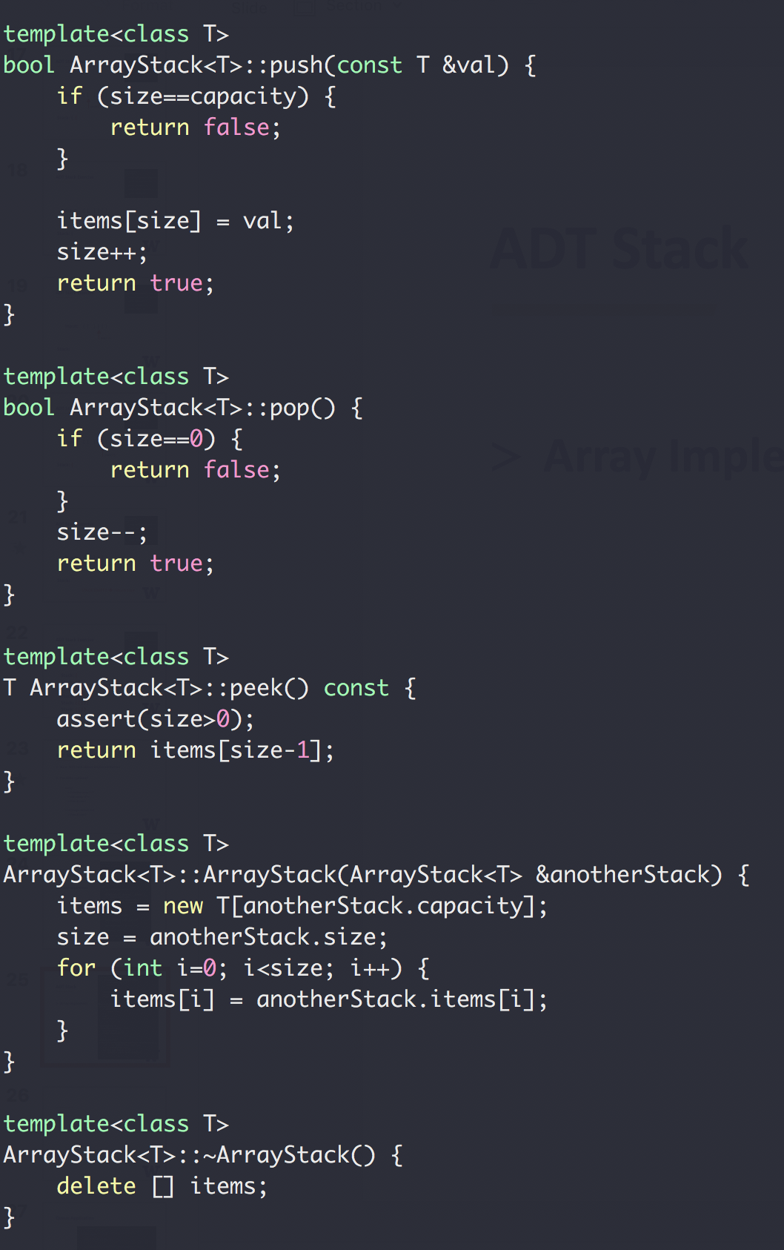
ADT Stack
Array Implement
PUSH
0 1 2 3
POP
0 1 2 3

Slide 25
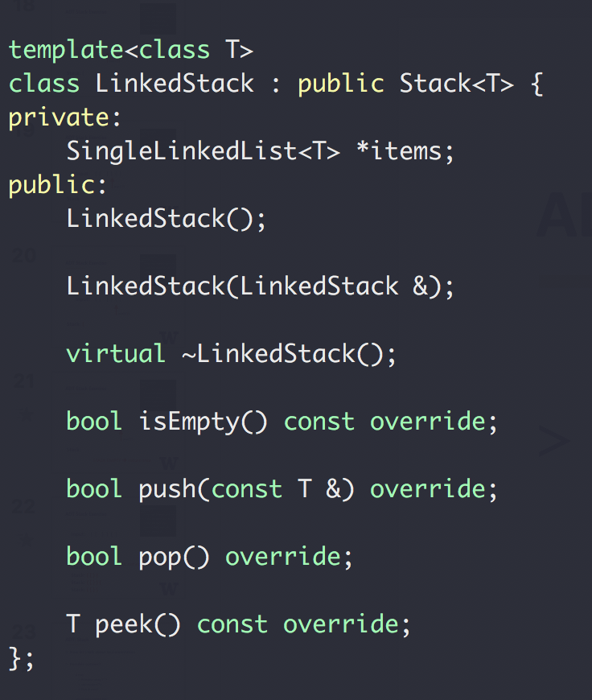
ADT Stack
Link Implement

Slide 26
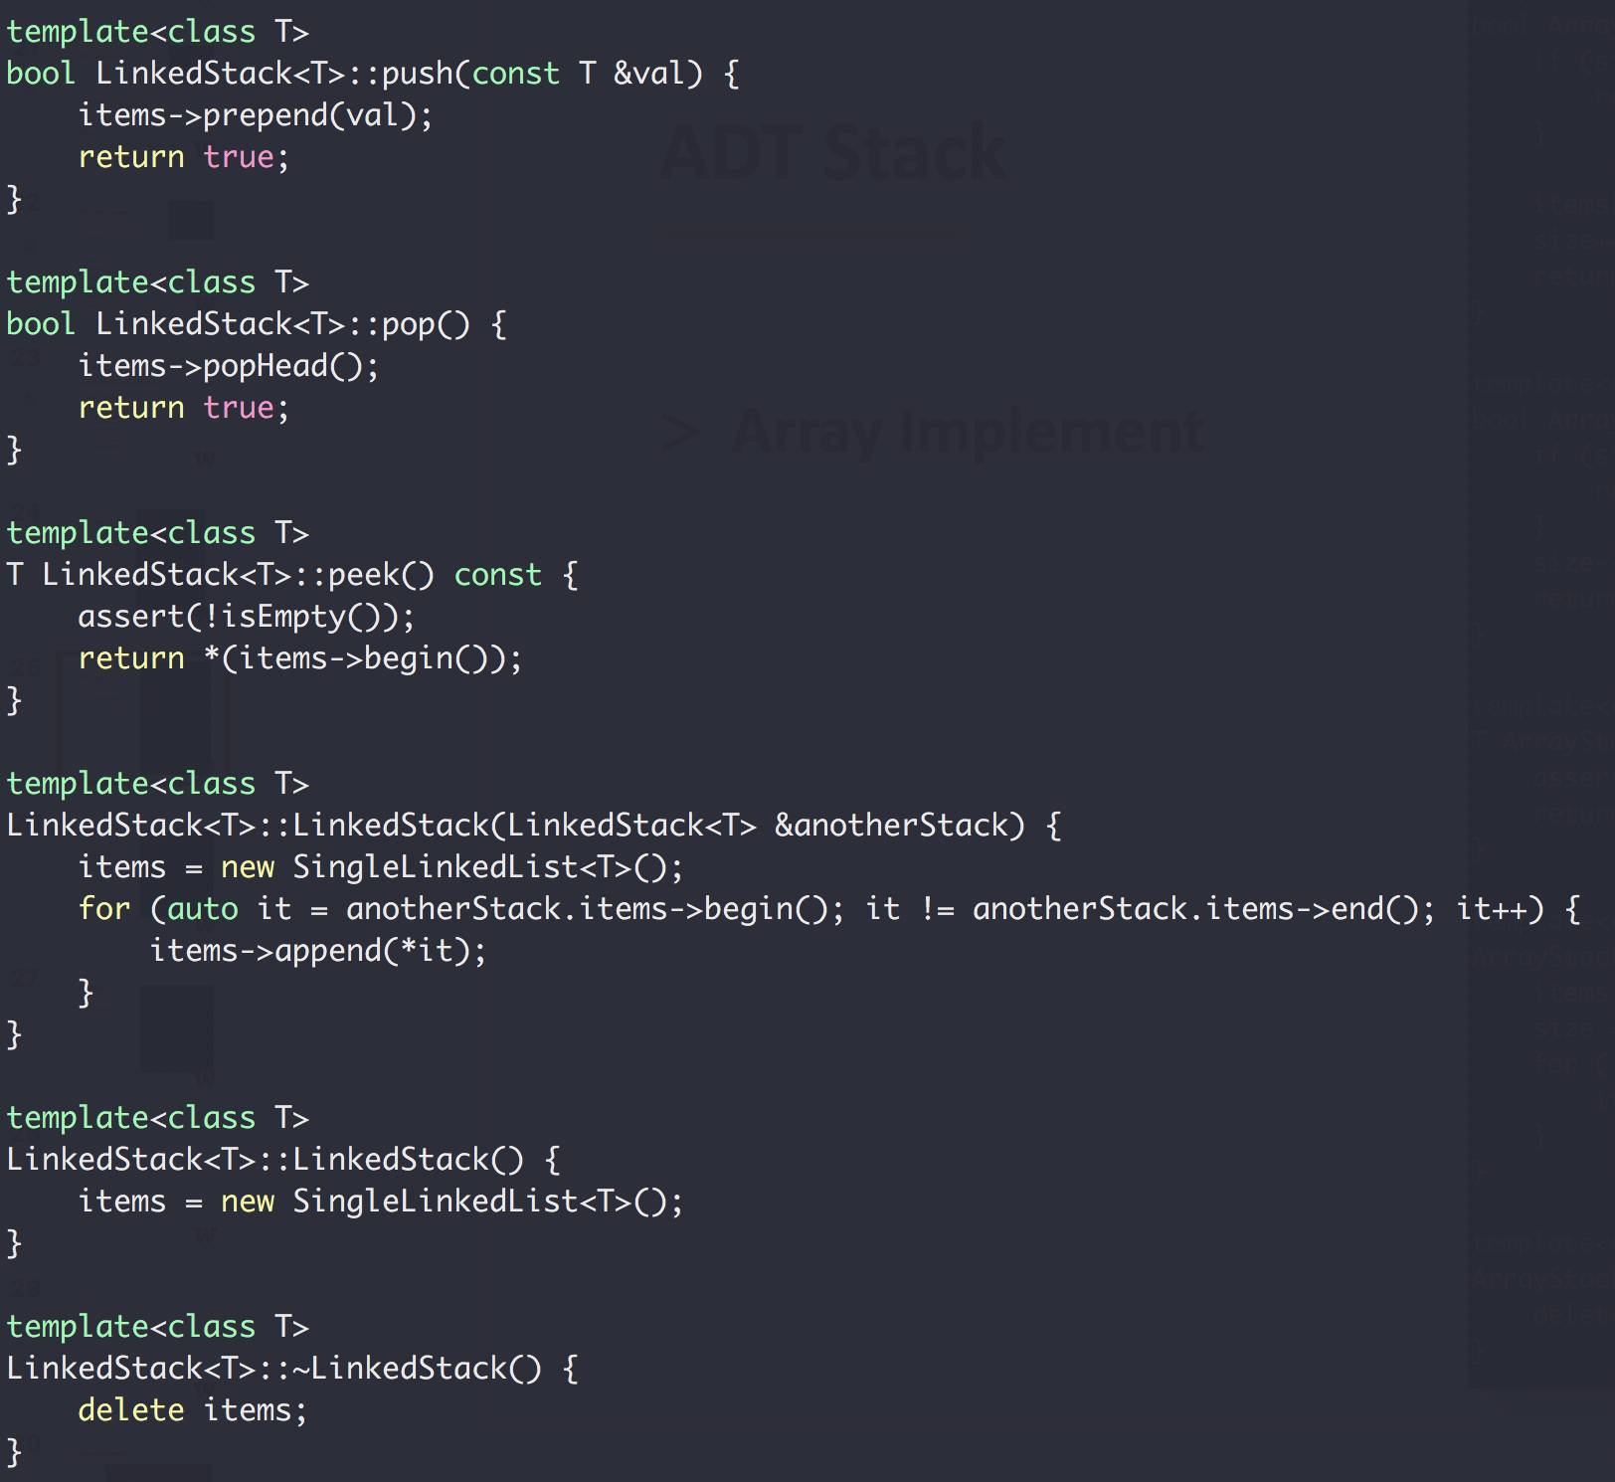

ADT Stack
val = 2
Next
head
val = 1
nullptr
Next
Next
Link
Implement
head
val = 1
val = 2
nullptr
Next
Next
Next

Slide 27
ADT: Queue
Design a Queue ADT
First in, first out (“first come, first serve”)
Usage: queueing scheduling system, message queue
Img: https://www.123rf.com/photo_52465854_stock-vector-passengers-in-queue-waiting-check-in-counters-at-airport.html

Slide 28
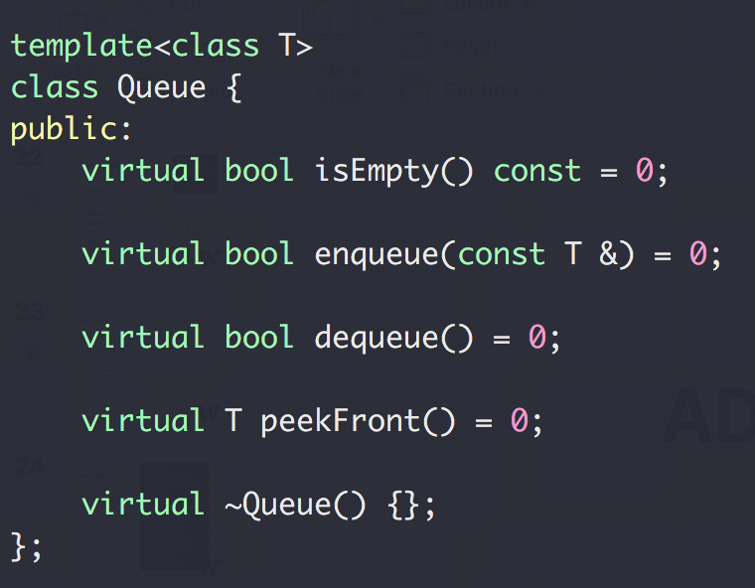
ADT Queue
Design a Queue ADT
First in, first out
Interface →

Slide 29
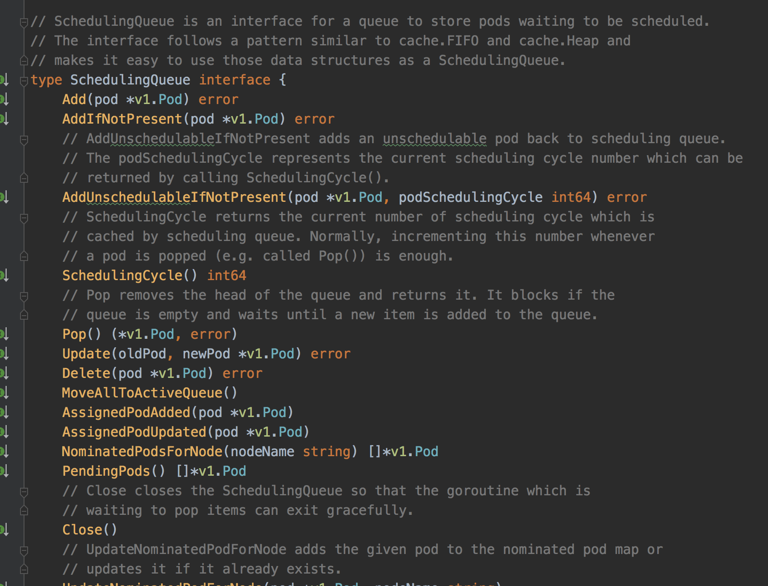
Queue example: Kubernetes Scheduler
pod
pod
pod
pod
pod
pod
pod
pod
Pod Queue
pod
pod
pod
pod
pod
pod
pod
pod
Scheduler
https://github.com/kubernetes/kubernetes

Slide 30
Queue Example: In the Linux Network Stack
Between the IP stack and the network interface controller (NIC) lies the driver queue.
This queue is typically implemented as a first-in, first-out (FIFO) ring buffer – just think of it as a fixed sized buffer.
The driver queue does not contain packet data. Instead it consists of descriptors which point to other data structures called socket kernel buffers (SKBs) which hold the packet data and are used throughout the kernel.
https://www.coverfire.com/articles/queueing-in-the-linux-network-stack/

Slide 31
Queue example: CPU Job Scheduling
Multiple-level queue scheduling
CPU BURST
I/O

Slide 32
Another Queue example
Priority Queue
Multiple-level queue scheduling
1 sec
2 sec
CPU
4 sec
8 sec
Only run tasks from a lower level queue if higher level queues are empty

Slide 33
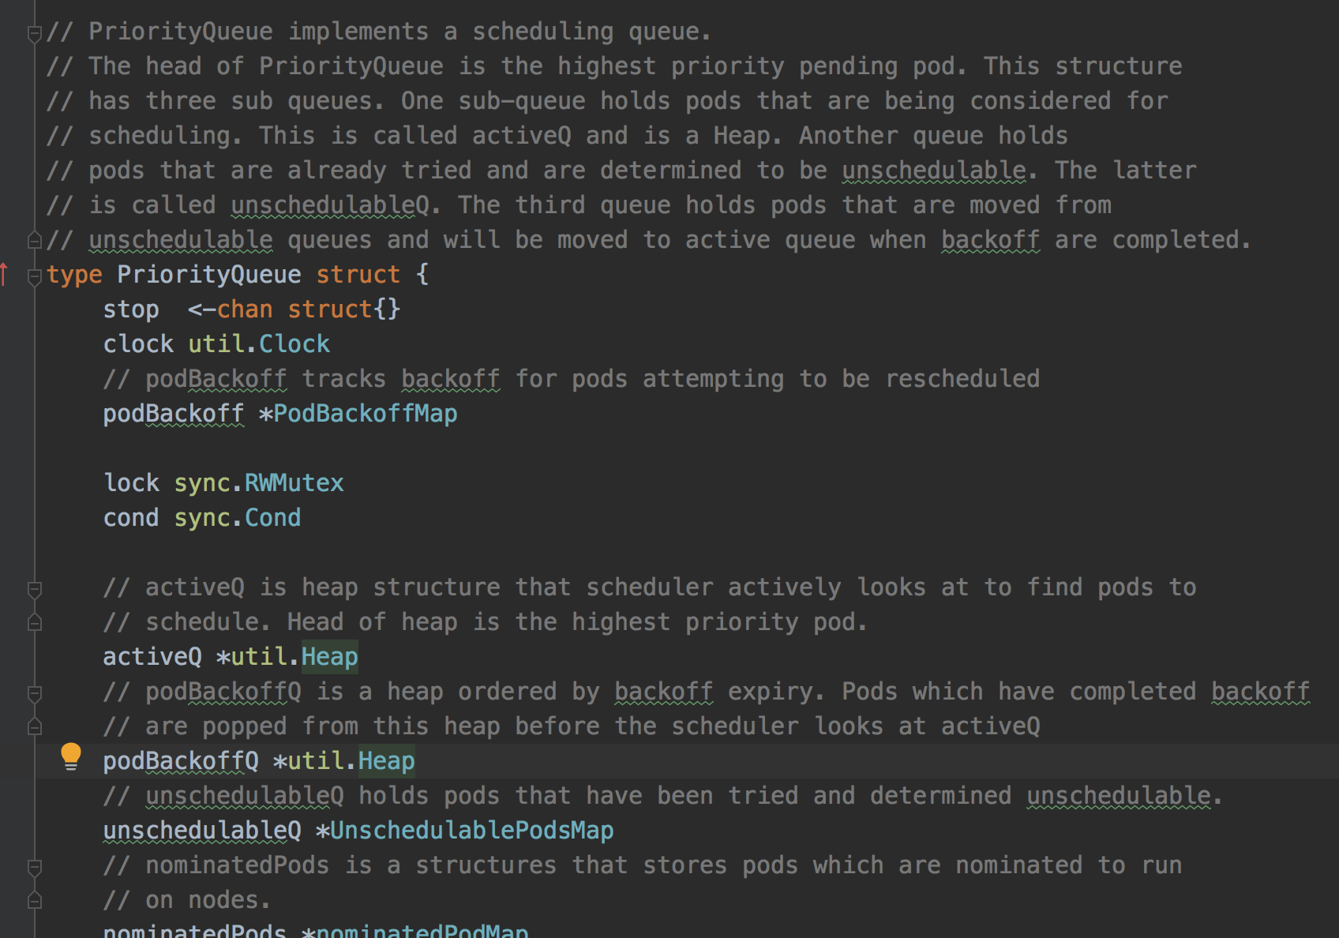
Another (Priority) Queue Example (also in K8s)
https://github.com/kubernetes/kubernetes/blob/master/pkg/scheduler/internal/queue/scheduling_queue.go#L112

Slide 34
ADT Queue
Now let’s talk about implementation
Possible options?
Array
Primitive array T **
std::vector<T*>
Pros & cons?
List (single linked list)
Pros & cons?

Slide 35
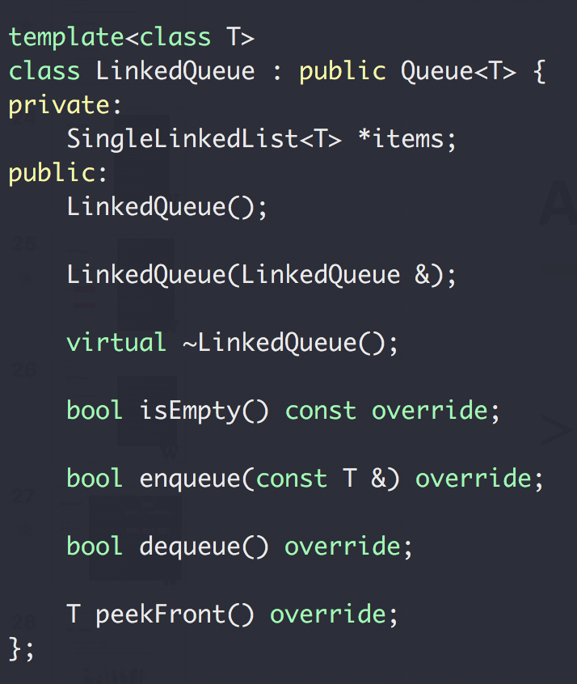
ADT Queue
Link Implement

Slide 36
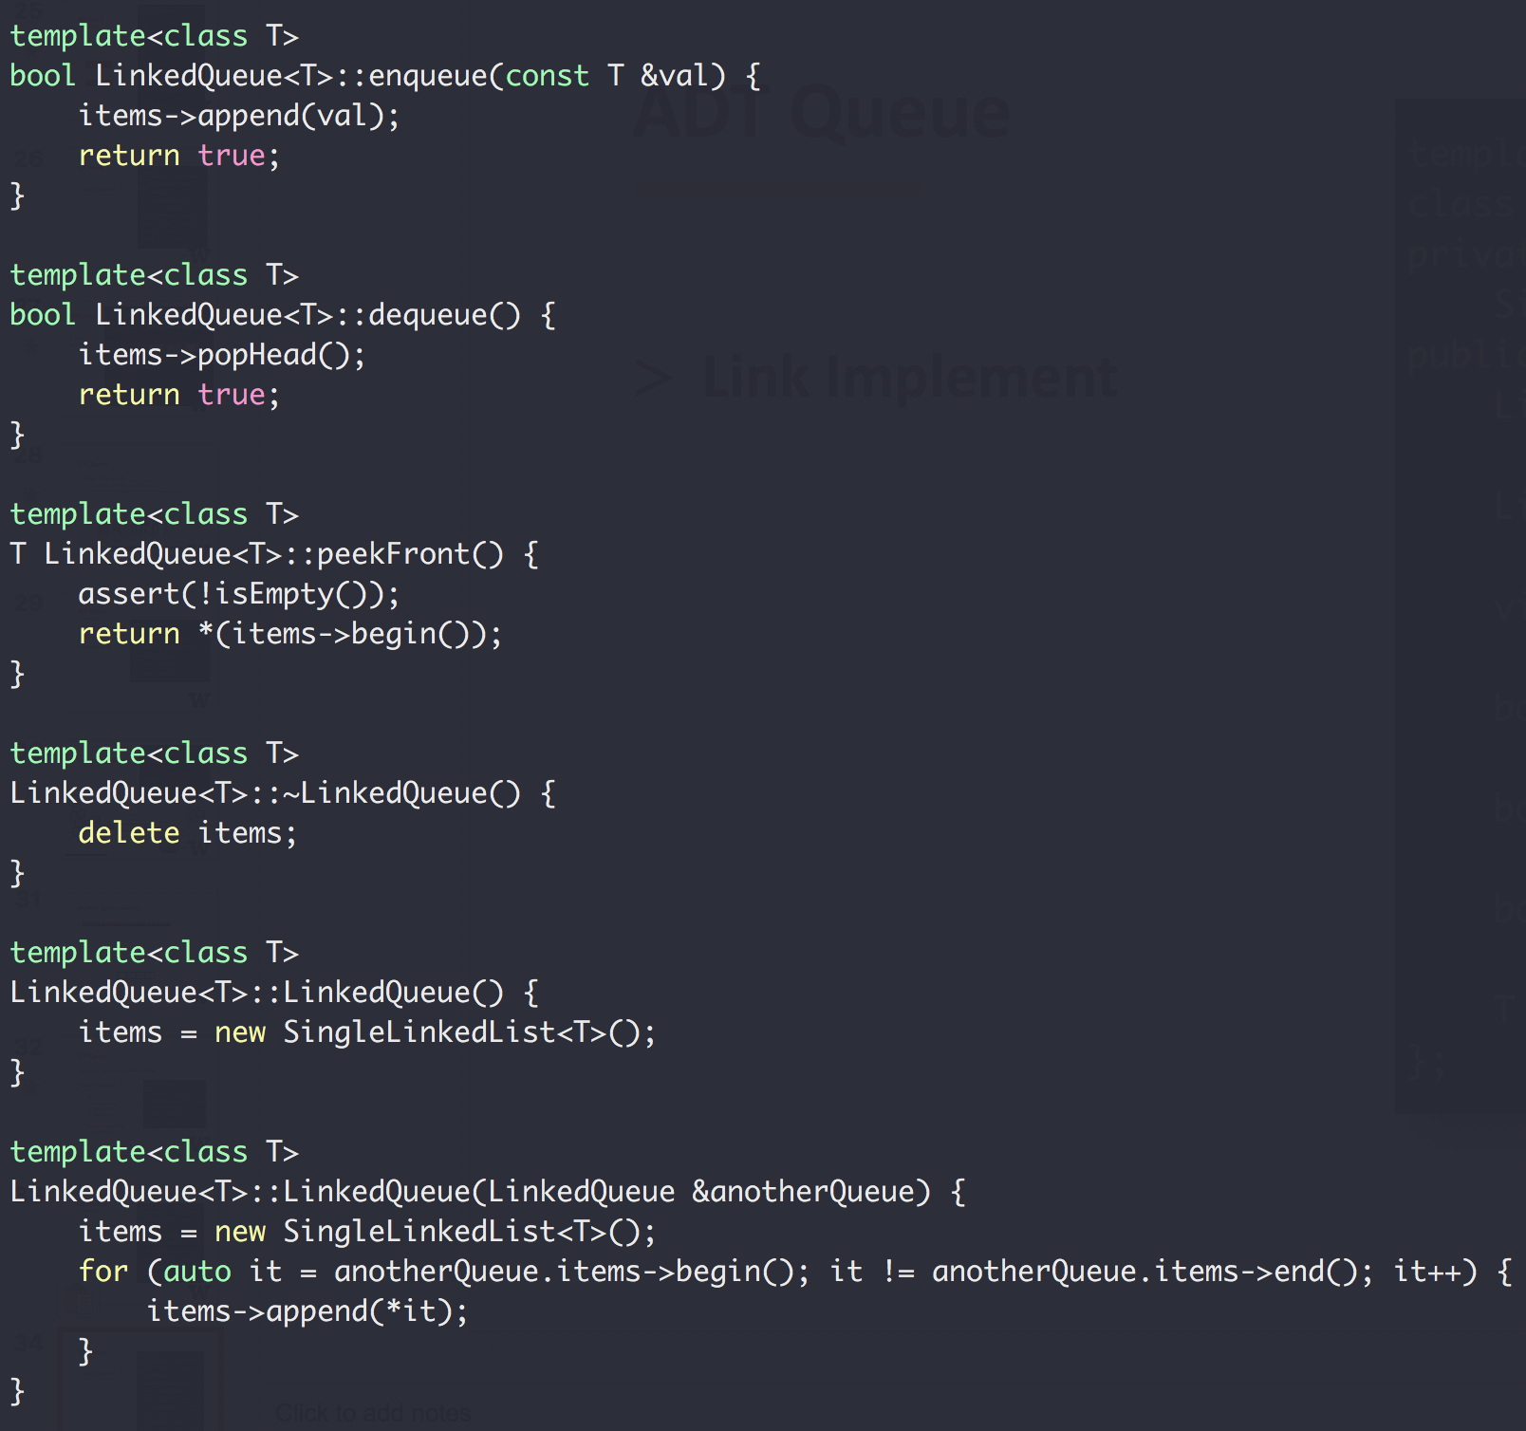

ADT Queue
val = 1
val = 2
val = 3
end
Next
Next
Next
Link
Implement
val = 1
val = 2
val = 3
end
Next
Next
Next

Slide 37
ADT Queue
Array Implement
enqueue
1
2
3
4
5
dequeue

Slide 38
ADT Queue
Array Implement
1
2
3
4
5
dequeue()
2
3
4
5
dequeue()
3
4
5
enqueue(6)
3
4
5
6
enqueue(7)
3
4
5
6
???

Slide 39
ADT Queue
Array Implement
1
2
3
4
5
dequeue()
2
3
4
5
dequeue()
3
4
5
enqueue(6)
3
4
5
6
enqueue(7)
7
3
4
5
6
enqueue(8)
7
8
3
4
5
6
Full!

Slide 40
ADT Queue
Array Implement
enqueue(6)
3
4
5
6
enqueue(7)
7
3
4
5
6
enqueue(8)
7
8
3
4
5
6
Full!
dequeue()
7
8
4
5
6
dequeue() x 4
8/8
dequeue()
empty

Slide 41
ADT Queue
Array Implement
endIdx
https://hyperskill.org/learn/step/5355
2
3
4
5
frontIdx

Slide 42
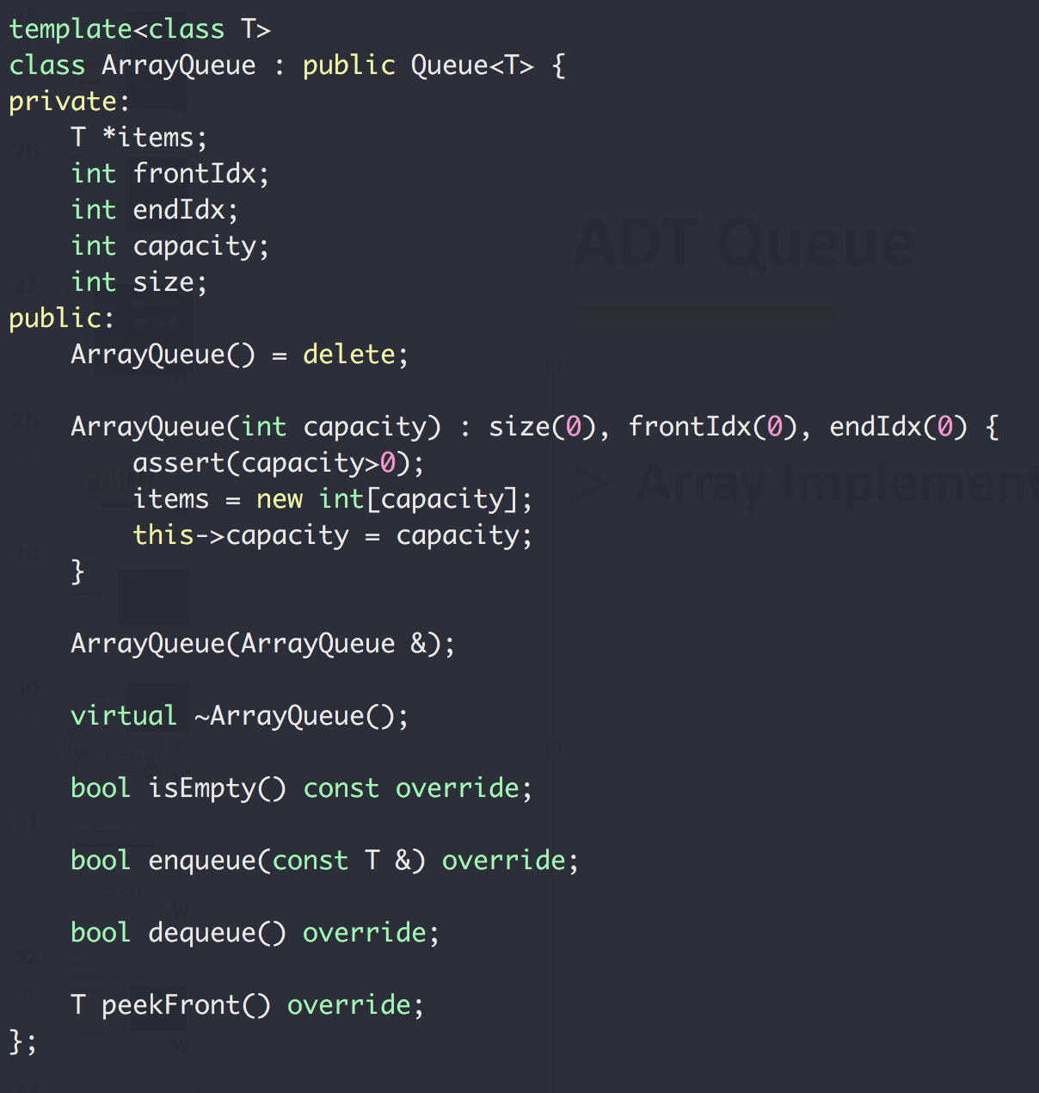
ADT Queue
Array Implement

Slide 43
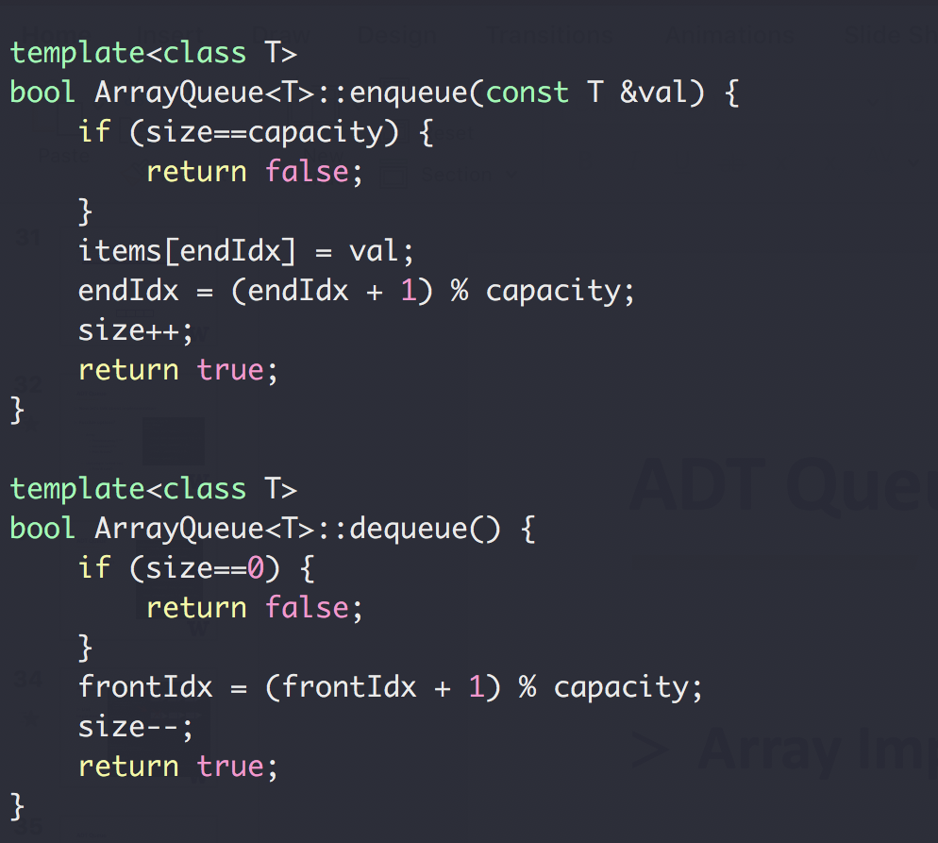
ADT Queue
Array Implement
0 % 4 = 0
1 % 4 = 1
2 % 4 = 2
3 % 4 = 3
4 % 4 = 0
5 % 4 = 1
6 % 4 = 2
… …
C++ mod(%) operator

Slide 44
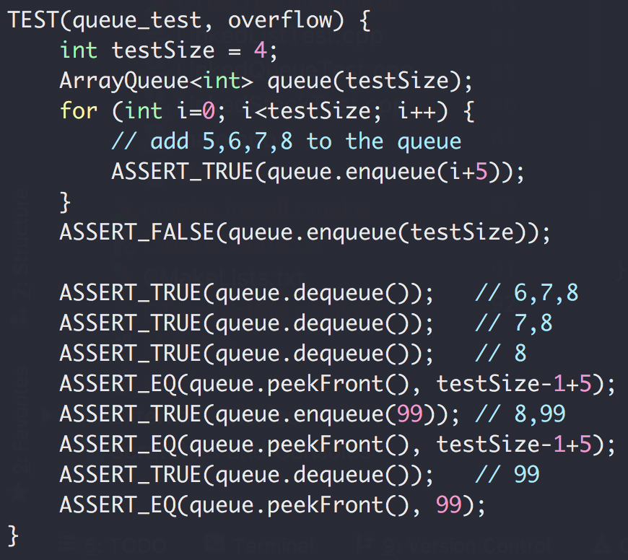
ADT Queue
Array queue test

Slide 45
ADT Queue
Array queue test
5
6
7
8
dequeue()
6
7
8
dequeue()
7
8
dequeue()
8/8
enqueue(99)
99
8
dequeue()
99/99

Slide 46
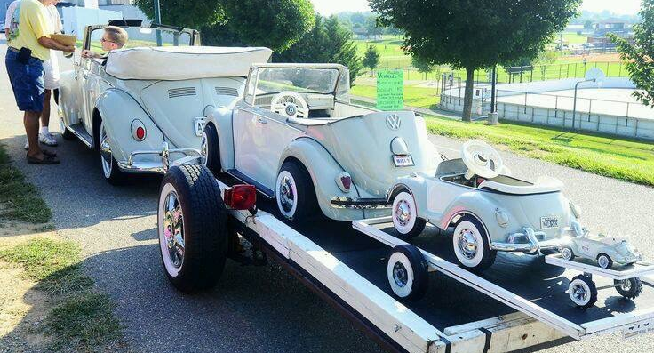
Recursion

Slide 47

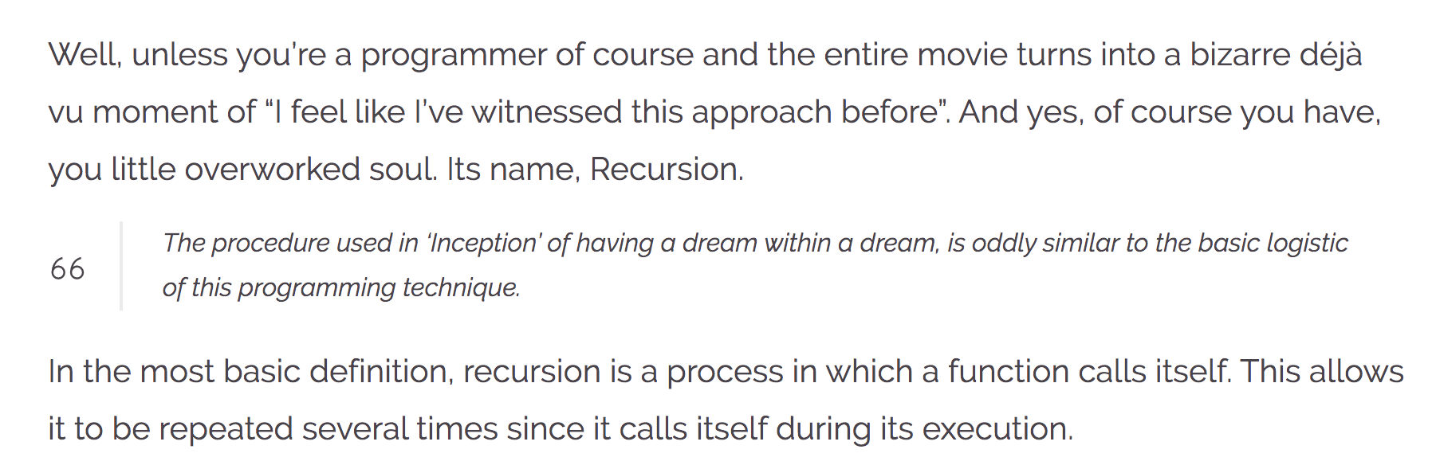
Recursion
https://wewrite.taleas.io/2018/11/14/why-inception-reminds-us-of-recursion/

Slide 48
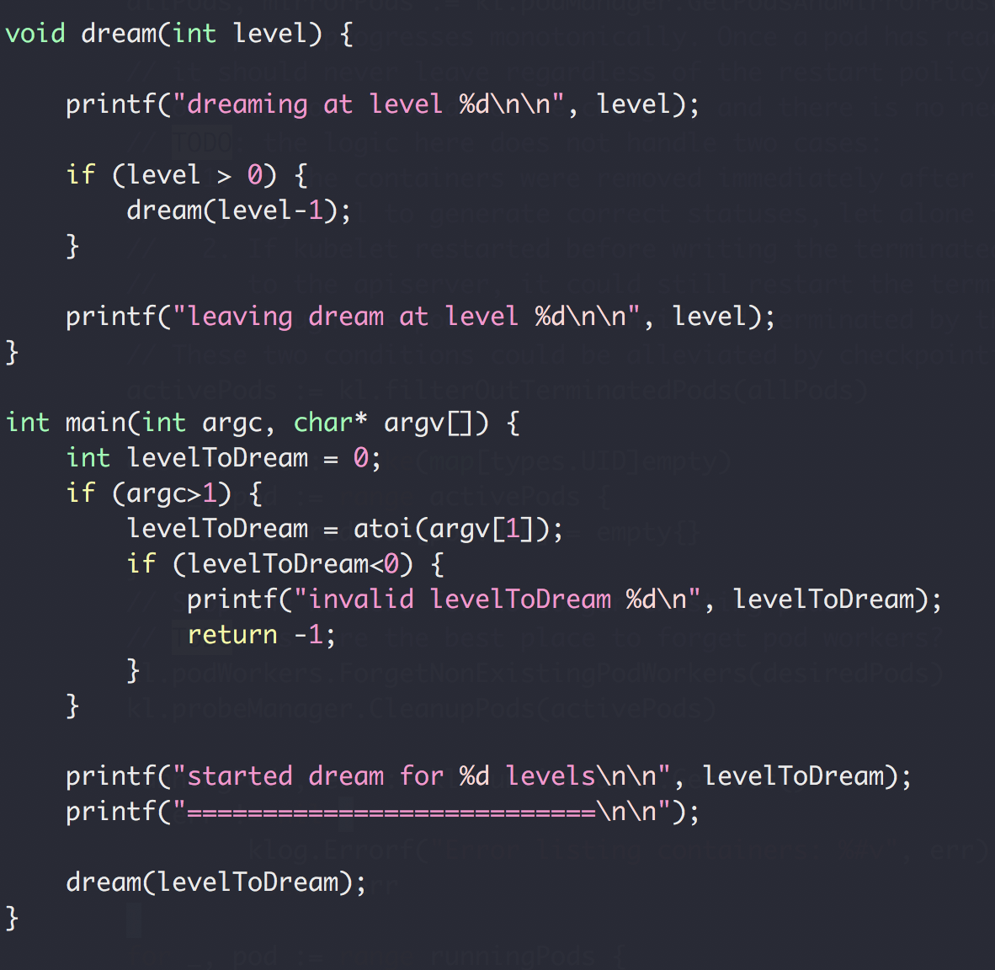
Dream in Recursion

Slide 49
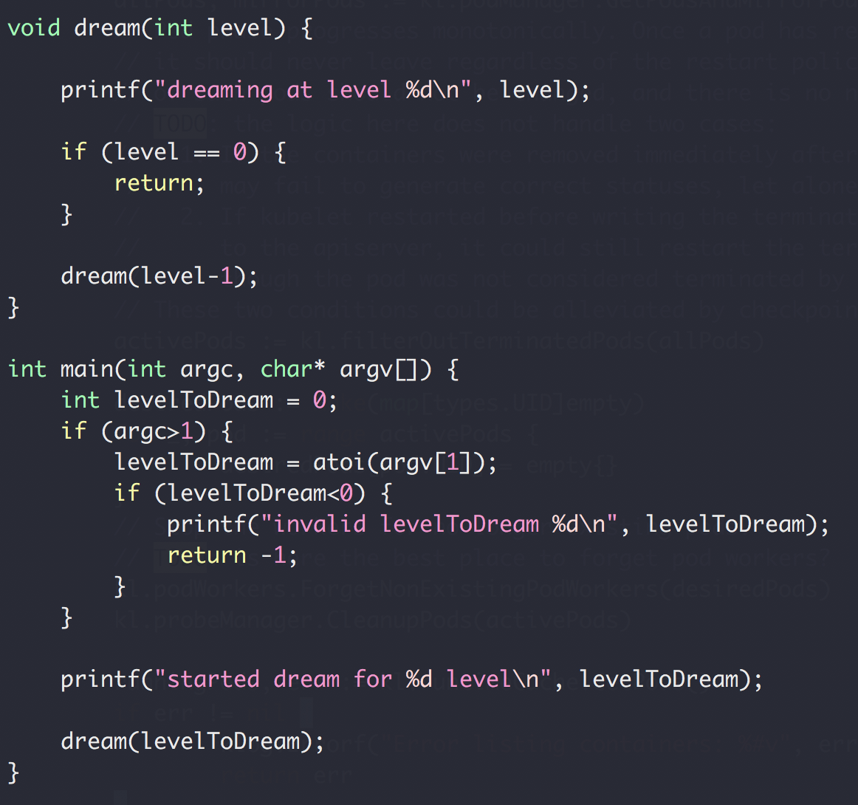
Recursion (and backtracking)
Recursion
Split a problem in a smaller subproblem of the same kind
Call self for each subproblem
Stop the recursion when the subproblem is ”small enough” and can be solved directly

Slide 50
Function Call Stack
Heap
Foo() {
// stack
int array1[10];
// heap
int * array2 = new int[20];
delete array2;
}
Foo() {
int array1[10];
int * array2 = new int[20];
delete array2;
}
Stack
Memory

Slide 51
Function Call Stack
Heap
Dream(1)
dream(0)
Dream(0)
Return address of dream(1)
Stack
dream(1)
Return address of main()
main()
Memory
Stack buffer overflow attack

Slide 52
Function Call Stack
Heap
dream(N-4)
Return address of dream(N-3)
dream(N-3)
Return address of dream(N-2)
dream(N-2)
Return address of dream(N-1)
Stack
dream(N-1)
Return address of main()
main()
Memory

Slide 53
Recursion (and backtracking)
Recursion
Split a problem in a smaller subproblem of the same kind
Call self for each subproblem
Stop the recursion when the subproblem is ”small enough” and can be solved directly

Slide 54
Recursion (and backtracking)
Recursion
Split a problem in a smaller subproblem of the same kind
Call self for each subproblem
Stop the recursion when the subproblem is ”small enough” and can be solved directly

Slide 55
Recursion (and backtracking)
How to find the largest apple
In box 0 to 5
0
1
2
3
4
5
Largest apple:
1
1
0

Slide 56
Recursion (and backtracking)
How to find the largest apple
In box 0 to 5 (noted as [0,5])
Get the first apple from [0,5]
Find the largest apple from [1,5]
compare it with apple 0
0
1
2
3
4
5

Slide 57
Recursion (and backtracking)
How to find the largest apple
In box 1 to 5
Get the first apple from [1,5]
Find the largest apple from 2-5
compare it with apple 1
0
1
2
3
4
5

Slide 58
Recursion (and backtracking)
How to find the largest apple
In box 2 to 5
Get the first apple from [2,5]
Find the largest apple from 3-5
compare it with apple 2
0
1
2
3
4
5

Slide 59
Recursion (and backtracking)
How to find the largest apple
In box 1 to 5
Get the first apple from [3,5]
Find the largest apple from 3-5
compare it with apple 3
0
1
2
3
4
5

Slide 60
Recursion (and backtracking)
How to find the largest apple
In box 1 to 5
Get the first apple from [4,5]
Find the largest apple from 4-5
compare it with apple 4
0
1
2
3
4
5

Slide 61
Recursion (and backtracking)
How to find the largest apple
In box 1 to 5
Only 1 apple is left, it’s the largest comparing to itself
0
1
2
3
4
5

Slide 62
Recursion (and backtracking)
How to find the largest apple
In box 1 to 5
Get the first apple from [4,5]
Find the largest apple from 4-5
compare it with apple 4
0
1
2
3
4
5

Slide 63
Recursion (and backtracking)
How to find the largest apple
In box 1 to 5
Get the first apple from [4,5]
Find the largest apple from 4-5
compare it with apple 4
0
1
2
3
4
5

Slide 64
Recursion (and backtracking)
How to find the largest apple
In box 1 to 5
Get the first apple from [3,5]
Find the largest apple from 3-5
compare it with apple 3
0
1
2
3
4
5

Slide 65
Recursion (and backtracking)
How to find the largest apple
In box 1 to 5
Get the first apple from [3,5]
Find the largest apple from 3-5
compare it with apple 3
0
1
2
3
4
5

Slide 66
Recursion (and backtracking)
How to find the largest apple
In box 2 to 5
Get the first apple from [2,5]
Find the largest apple from 3-5
compare it with apple 2
0
1
2
3
4
5

Slide 67
Recursion (and backtracking)
How to find the largest apple
In box 1 to 5
Get the first apple from [1,5]
Find the largest apple from 2-5
compare it with apple 1
0
1
2
3
4
5

Slide 68
Recursion (and backtracking)
How to find the largest apple
In box 1 to 5
Get the first apple from [1,5]
Find the largest apple from 2-5
compare it with apple 1
0
1
2
3
4
5

Slide 69
Recursion (and backtracking)
How to find the largest apple
In box 1 to 5
Get the first apple from [1,5]
Find the largest apple from 2-5
compare it with apple 1
0
1
2
3
4
5

Slide 70
Recursion (and backtracking)
How to find the largest apple
In box 0 to 5 (noted as [0,5])
Get the first apple from [0,5]
Find the largest apple from [1,5]
compare it with apple 0
0
1
2
3
4
5

Slide 71
Recursion (and backtracking)
How to find the largest apple
In box 0 to 5 (noted as [0,5])
Get the first apple from [0,5]
Find the largest apple from [1,5]
compare it with apple 0
0
1
2
3
4
5

Slide 72
A similar question
Find the largest number in an array
Array not sorted
interger
0
1
2
3
4
5

Slide 73
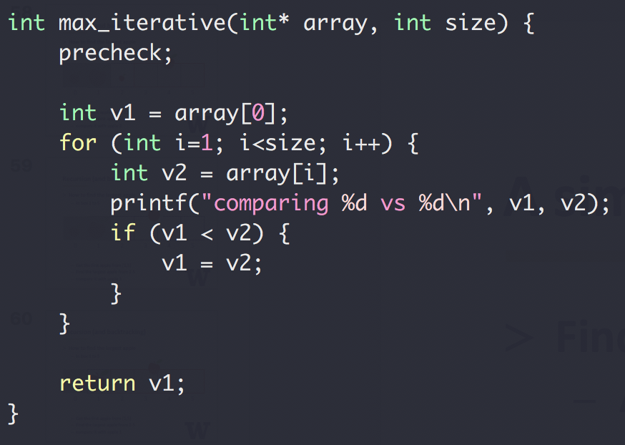
A similar question
Find the largest number in an array
Array not sorted
Integer
Method 1
Iterative

Slide 74
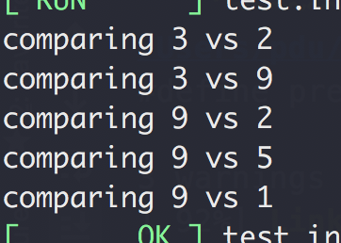
A similar question
Find the largest number in an array
Array not sorted
Integer
Method 1
Iterative
Input: [3,2,9,2,5,1]

Slide 75
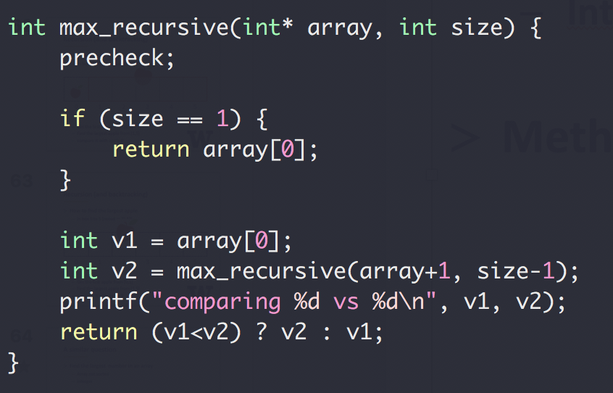
A similar question
Find the largest number in an array
Array not sorted
Integer
Method 2
Recursive

Slide 76
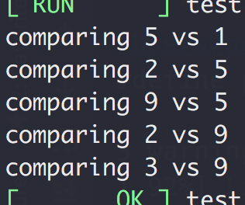
A similar question
Find the largest number in an array
Array not sorted
Integer
Method 1
Recursive
Input: [3,2,9,2,5,1]

Slide 77
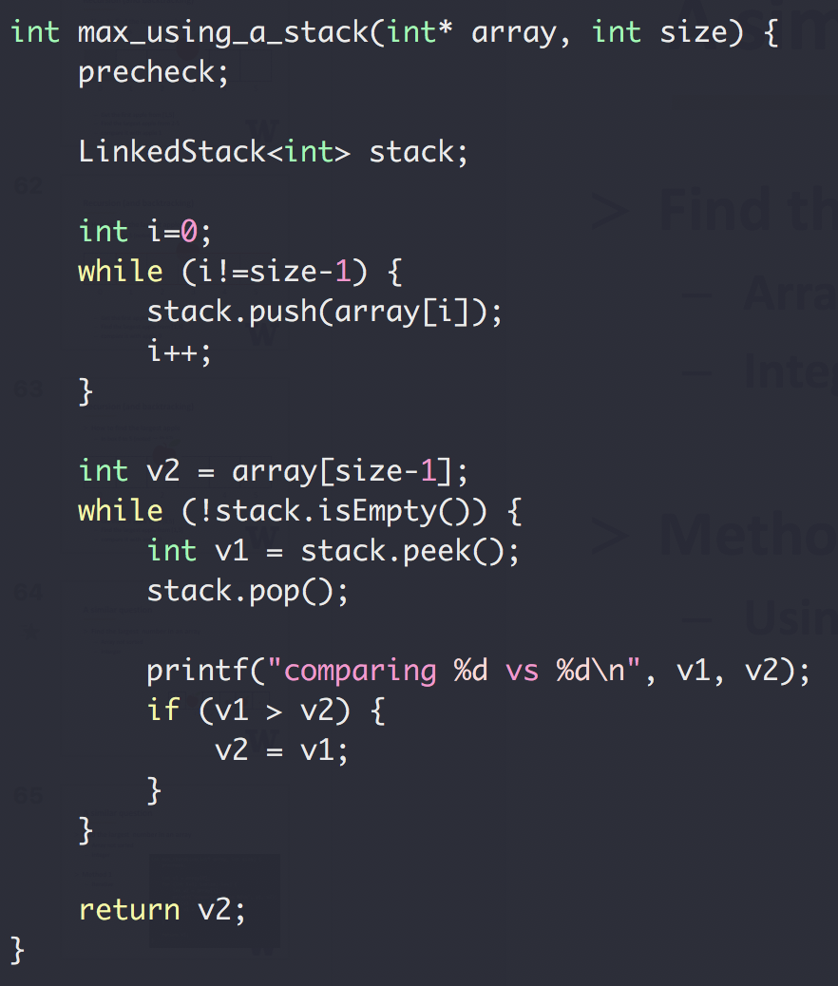
A similar question
Find the largest number in
an array
Array not sorted
Integer
Method 3
Using a stack

Slide 78
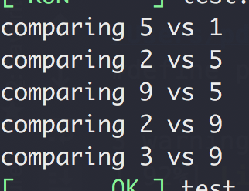
A similar question
Find the largest number in
an array
Array not sorted
Integer
Method 3
Using a stack
Input: [3,2,9,2,5,1]

Slide 79
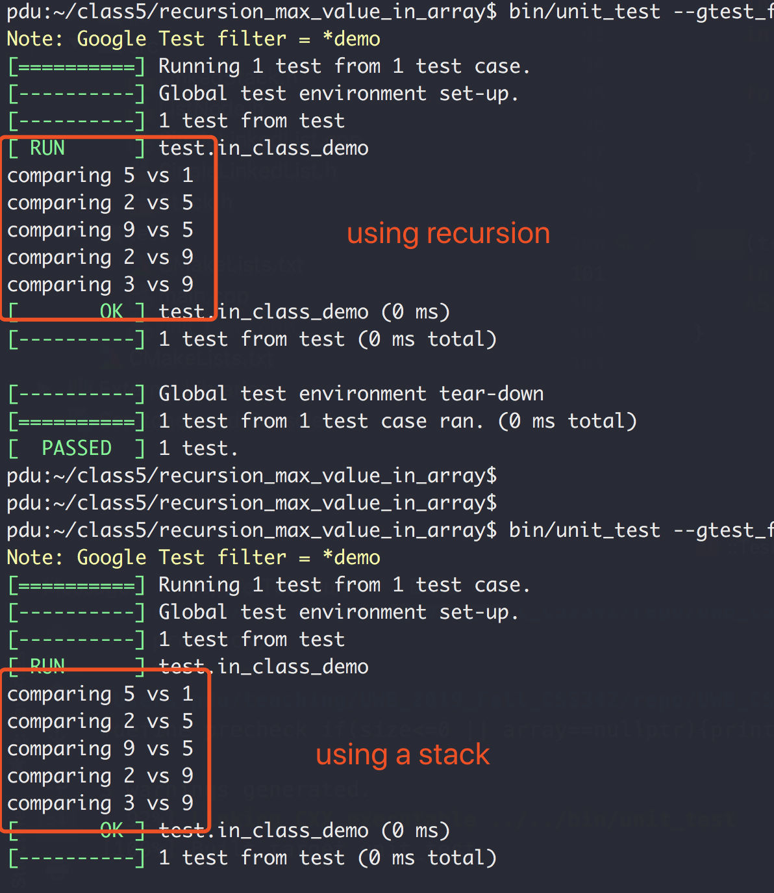
Recursion vs Stack

Slide 80
Recursion
Binary Search
Linear Search (target 12)
5 3 1 9 8 7 12 2 4
5 3 1 8 7 9 2 4 12
O(N) Can we do better?
Worse case we have to iterate N element

Slide 81
Binary Search
“Who checked that bug in?!!”
Source control svn, git, etc
1
2
3
4
5
6
7
8
9
10
Mike
Peng
Ethan

Slide 82

Binary Search
“Who checked that bug in?!!”
Source control svn, git, etc
Found a bug in version 10
No bug in version 1
?
?
?
?
?
?
?
?
1
2
3
4
5
6
7
8
9
10

Slide 83
Binary Search
Source control svn, git, etc
“Who checked that bug in?!!”
Found a bug in version 10
No bug in version 1
?
?
?
?
?
?
?
?
1
2
3
4
5
6
7
8
9
10

Slide 84
Binary Search
Source control svn, git, etc
“Who checked that bug in?!!”
Found a bug in version 10
No bug in version 1
?
?
?
?
?
?
?
?
1
2
3
4
5
6
7
8
9
10

Slide 85
Binary Search
Source control svn, git, etc
“Who checked that bug in?!!”
Found a bug in version 10
No bug in version 1
?
?
?
?
?
1
2
3
4
5
6
7
8
9
10
Bug introduced, found with 3 checks

Slide 86
Binary Search
Binary Search (target 12)
1 2 3 4 5 7 8 9 12
1 2 3 4 5 7 8 9 12
1 2 3 4 5 7 8 9 12
1 2 3 4 5 7 8 9 12
1 2 3 4 5 7 8 9 12
O(logN) both average and worst case

Slide 87
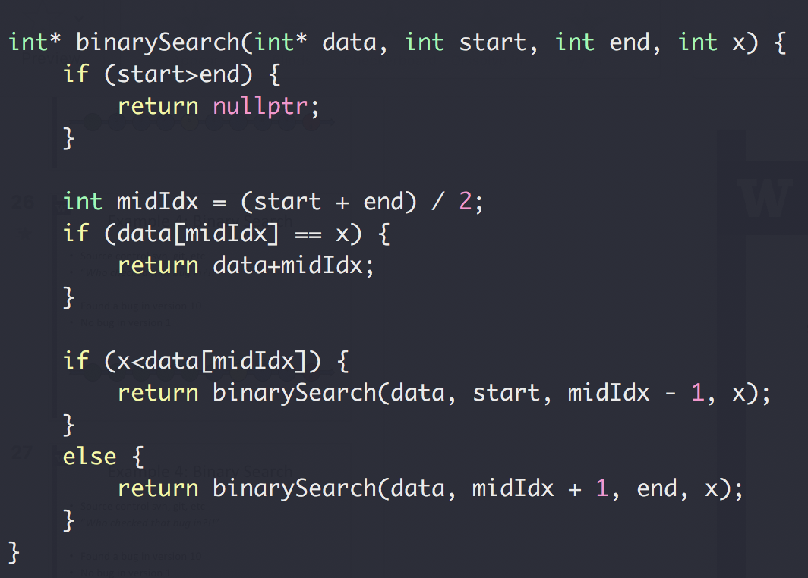
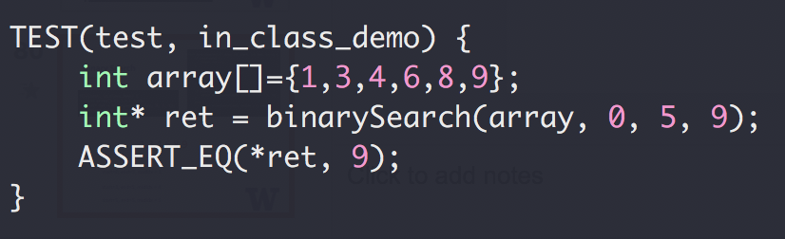
Binary Search

Slide 88
Binary Search
1,3,4,6,8,9
start=0, end=5, midIdx = 2
start=3, end=5, midIdx = 4
start=5, end=5, midIdx = 5

Slide 89
Binary Search
Up to 2³¹-1 for 32-bit signed int
What could go wrong?
The Java programming language library had this bug for 20+ years

Slide 90
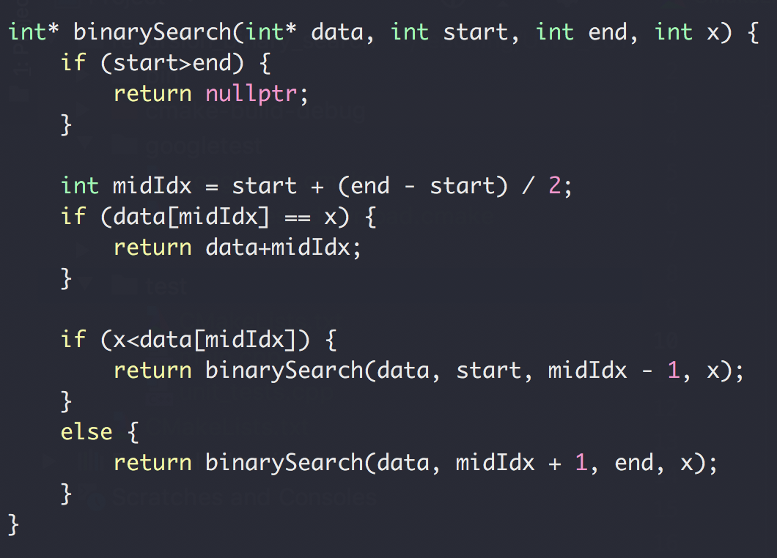
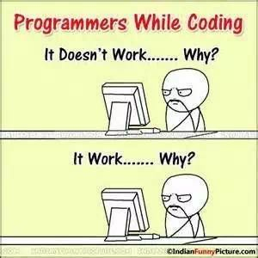
Binary Search

Slide 91
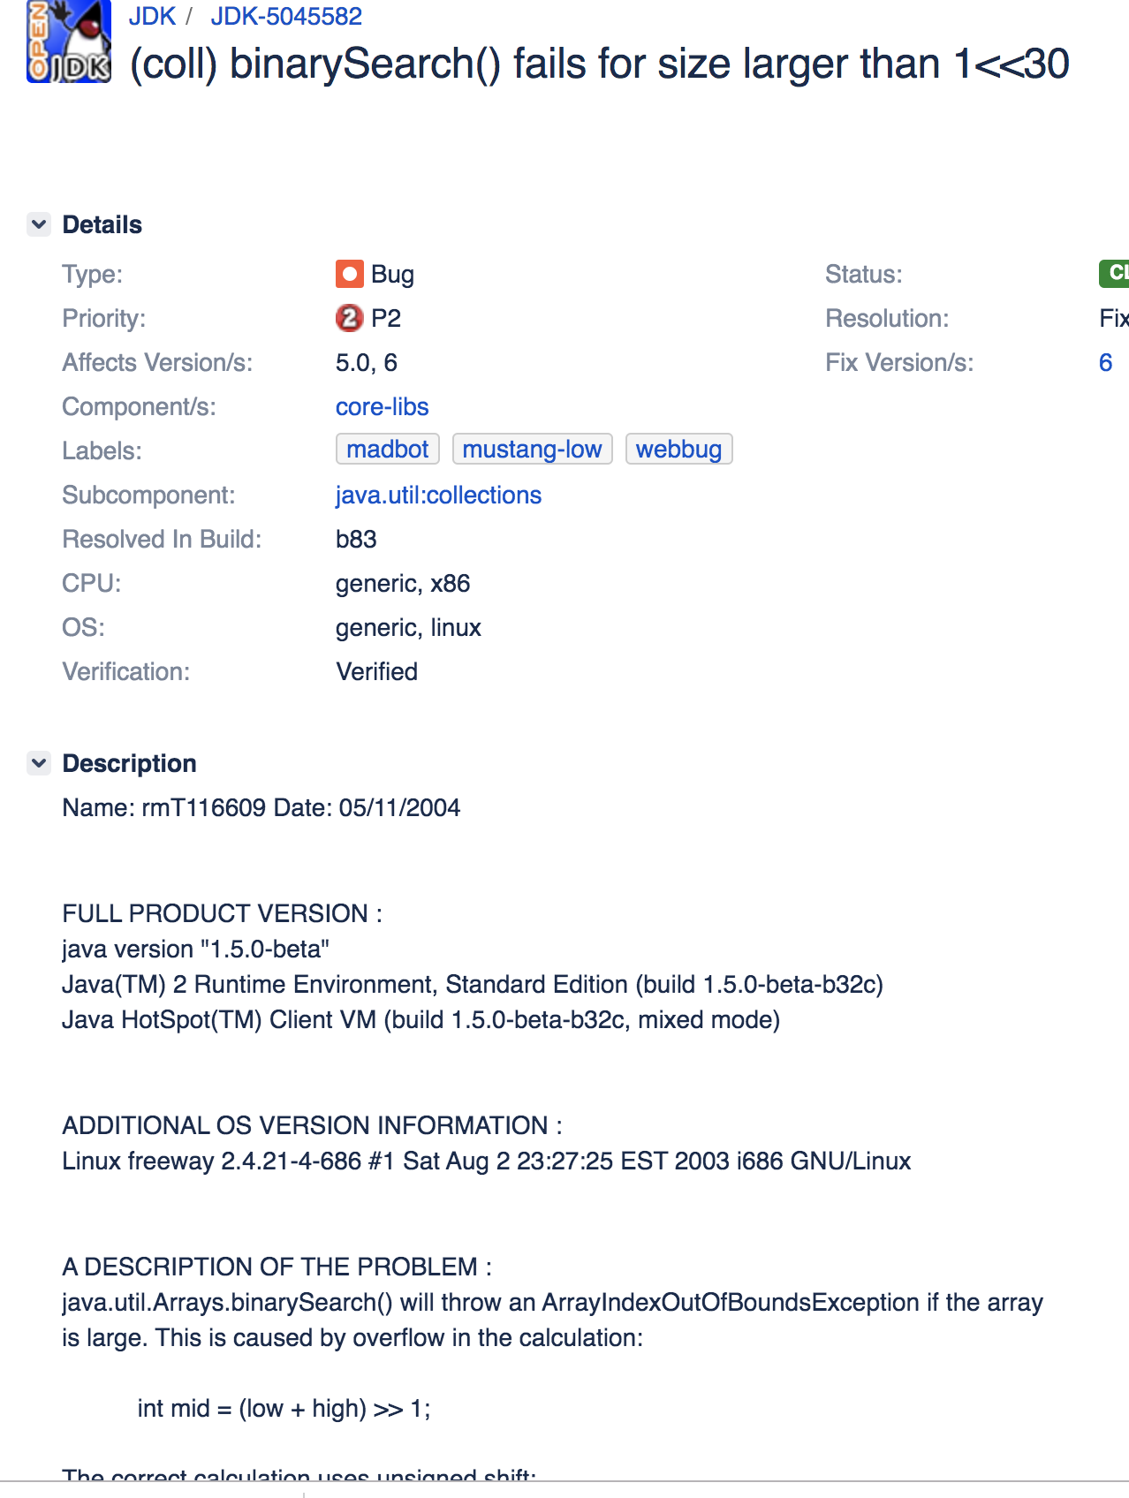
Binary Search
https://bugs.openjdk.java.net/browse/JDK-5045582

Slide 92
Backtracking

